Slide 1

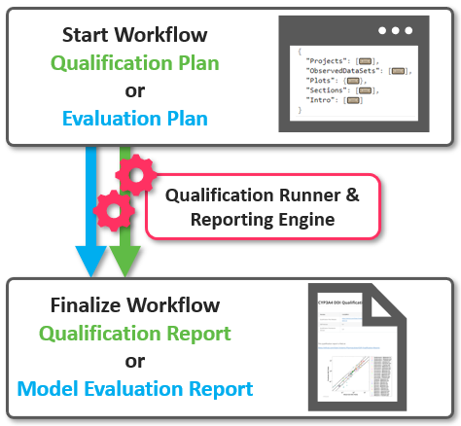



Modeling Tools
Qualification Framework
Import
Excel® CSV
NONMEM® SBML
PBPK modeling & simulation
Export
Excel® CSV
PDF JSON
OSP Model exchange format
(PKML)
(PB)QSP modeling & simulation
Validation/Automation Tools
R packages
OSP Toolboxes / Interfaces
Reporting Engine
Plot-Library (TLF)
PI (in dev.)
…
Installation Validator
Command Line Interface (CLI)
…
R (statistical computing)
PBPK:
(PB)QSP:
Physiologically based pharmacokinetic
(Physiologically based) Quantitative systems pharmacology
TLF:
PI:
Tables, listings and figures
Parameter identification

Slide 2

Modeling Tools
Qualification Framework
Import
Excel® CSV
NONMEM® SBML
PBPK modeling & simulation
Export
Excel® CSV
PDF JSON
OSP Model exchange format
(PKML)
(PB)QSP modeling & simulation
Validation/Automation Tools
R packages
OSP Toolboxes / Interfaces
Reporting Engine
Plot-Library (TLF)
PI (in dev.)
…
Installation Validator
Command Line Interface (CLI)
…
R (statistical computing)
Matlab (technical computing)
Deprecated!
PBPK:
PB(QSP):
Physiologically based pharmacokinetic
(Physiologically based) Quantitative systems pharmacology
TLF:
PI:
Tables, listings and figures
Parameter identification

Slide 3

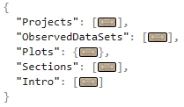


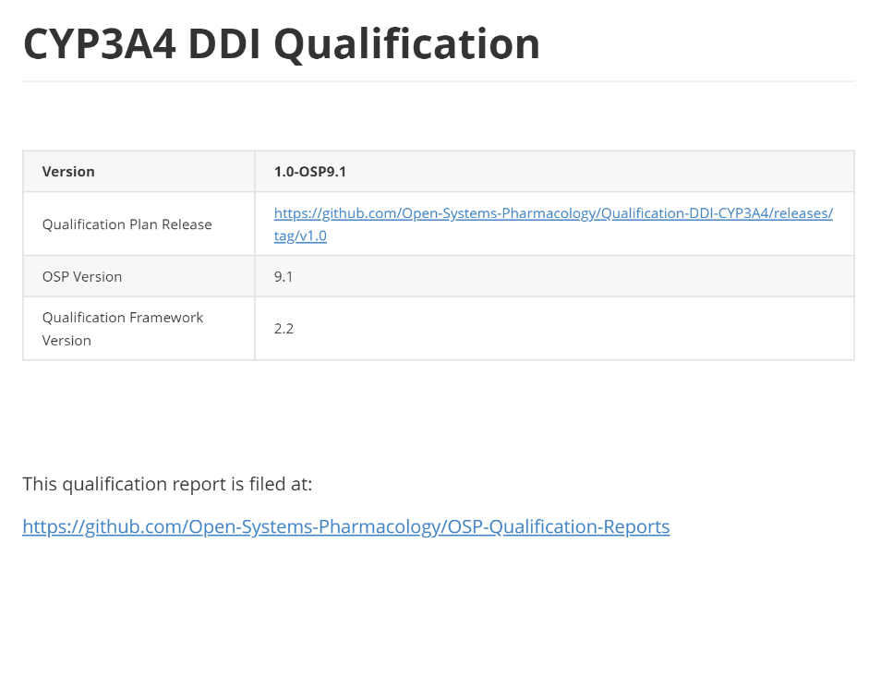
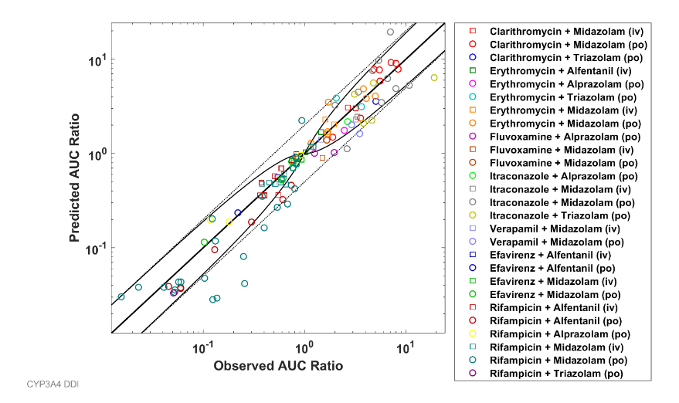
Start Workflow Qualification Plan or Evaluation Plan
Qualification Runner & Reporting Engine
Finalize Workflow Qualification Report or Model Evaluation Report

